Slide 1

Movie Data Analysis for Microsoft
By Janet Khainza

Slide 2

Microsoft is planning to establish a new movie studio, and it is crucial to consider essential factors that can enhance profitability. Through an analysis of historical data, we have discovered valuable insights that can aid in ensuring that a film production delivers a strong performance while also providing an efficient return on investment.

Slide 3

To provide information to Microsoft so they can assess the criteria for a successful entry into the movie production business.

Slide 4
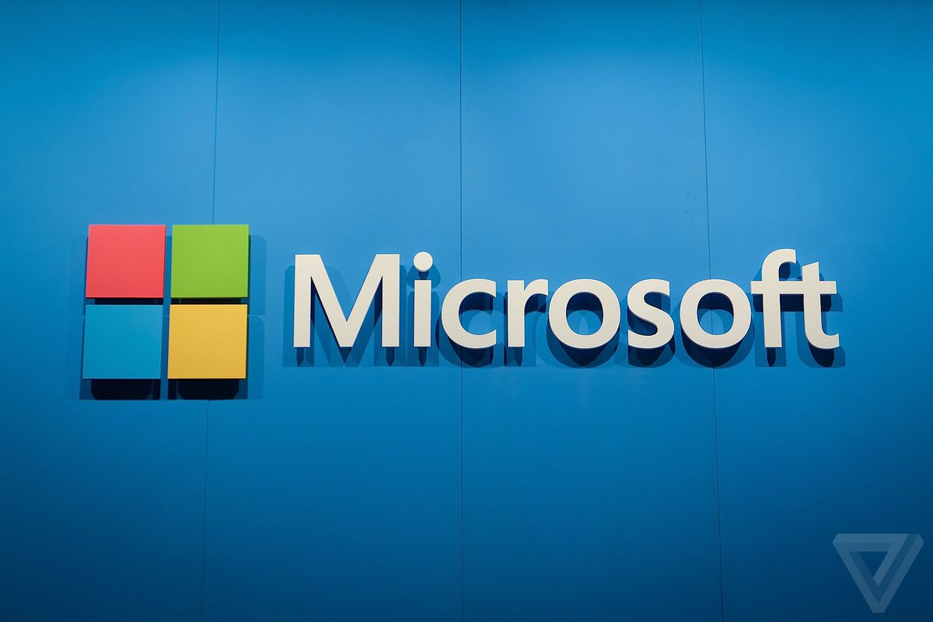
Business Problem
Microsoft wants a piece of the multi-billion dollar movie-making industry, but that they are unsure of where to begin. The challenge for their new movie studio is that they are ready to jump into the industry but do not have the necessary knowledge to move forward.
Microsoft also wants to make sure that their own movie studio will have a greater chance of success within the digital content market.

Slide 5

Data Sources
My analysis comprised of data acquired from the following sources:
The Movie Database
The Numbers Movie Budgets
Box Office Mojo.

Slide 6


Data Methods
Data cleaning – Dealing with missing data
Converting column types – Ensuring that data in the columns are in the correct type to allow for data manipulation
Feature engineering – Creating new columns in the data to create more insights
Data analysis – Exploration of data to establish meaningful insights
Data visualization - visual representations using charts, graphs, etc to communicate complex data in a clear and understandable manner

Slide 7

Key Findings
Higher production budgets does not necessarily mean higher returns.
Microsoft may face challenges entering the film industry despite potentially acquiring IP rights from top studios due to lack of experience in film production.
Consider popular genres for movie creation.

Slide 8
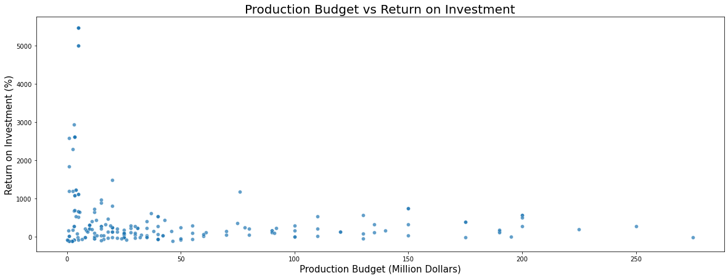
1. Production Budget Vs Return on Investment Graph

Slide 9

Correlation: ROI vs Production Budget
The weak positive correlation between production budget and return on investment suggests that higher production budgets do not necessarily guarantee higher returns.
This means that Microsoft may need to carefully manage its production costs and investments to ensure a profitable return on investment

Slide 10
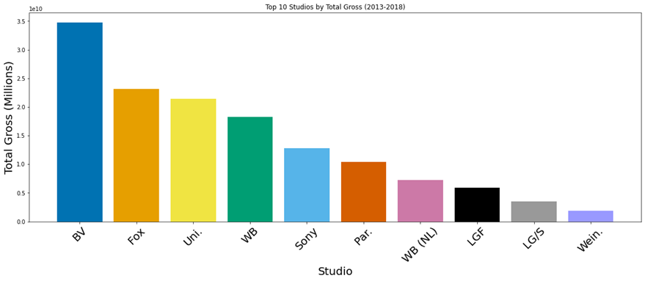
2. Best Performing Studios in terms of Gross Income

Slide 11

The top 5 performing studios in terms of gross income are:
1.Walt Disney Studios - BV
2. Warner Bros. Pictures
3. 20th Century Fox
4. Universal Pictures
5.Warner Bros. Pictures

Slide 12
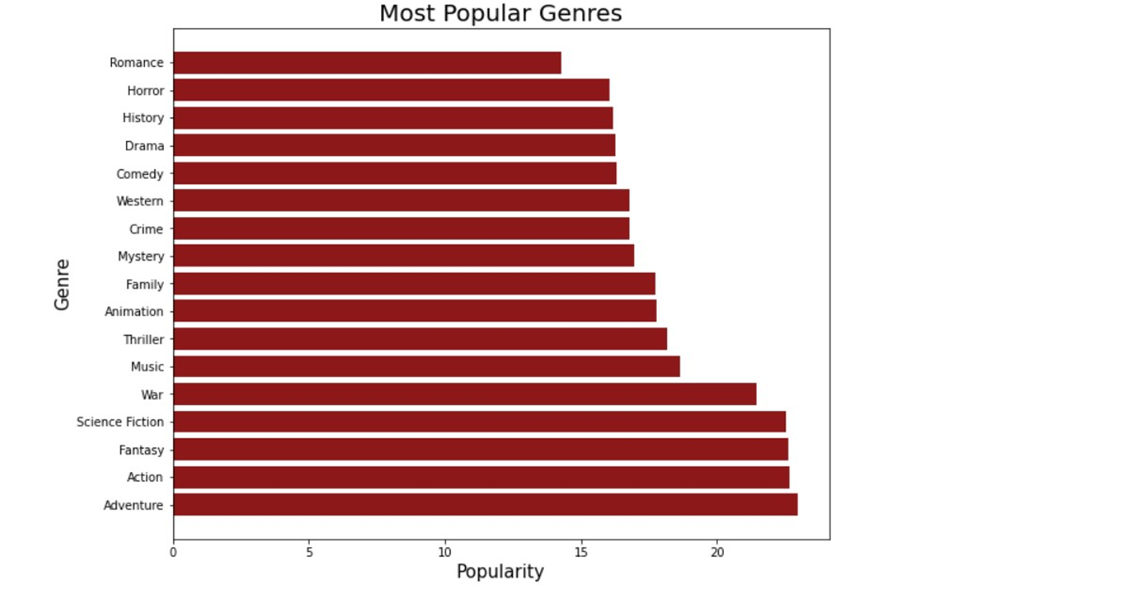
3. Popular genres

Slide 13
Genre Popularity
My analysis shows that the following genres are quite popular with movie lovers:
Adventure
Action
Fantasy
Science Fiction
War

Slide 14
Conclusion and Recommendations
For Microsoft to get it right in the Movie Industry:
Enter the film industry by obtaining intellectual property rights from top movie studios
Microsoft will need to carefully manage its production costs and investments
Focus on high-budget productions
Consider producing films in popular and profitable genres such as Horror, Music, Action, and Adventure.

Slide 15


